Slide 1

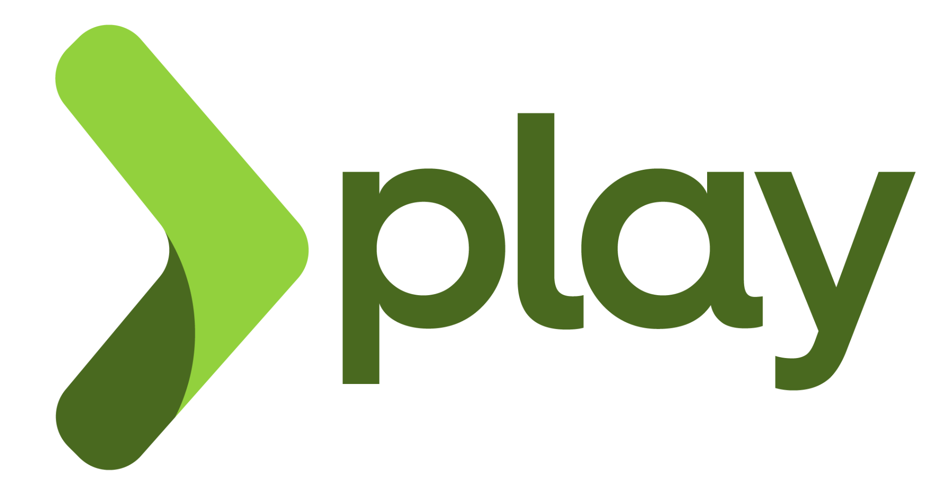
Play Framework 3.0
High Performance & Reactive Architecture on the JVM
Notes:
Hello guys, today I wil talk about Play Framework.
Lets get started

Slide 2
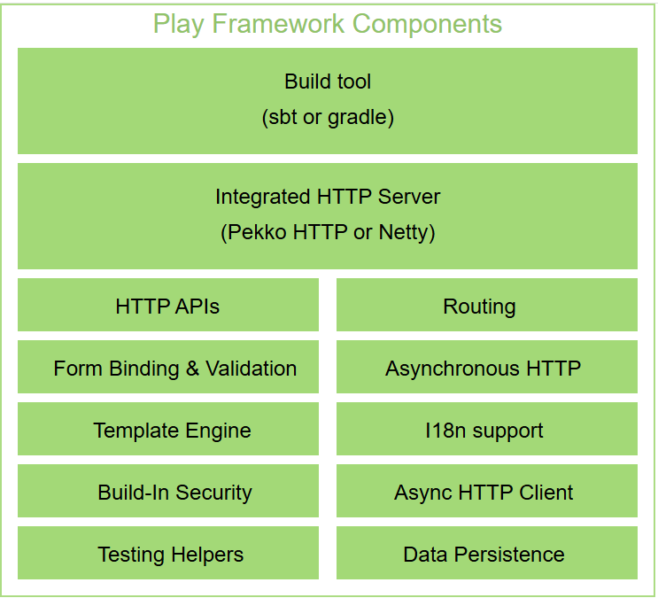


WHAT IS PLAY 3.0?
Open-source web framework designed for the rapid development of Java and Scala applications
Reactive and Asynchronous Architecture
MVC Model and Stateless Design
Built on Apache Pekko (Open Source).
Developer Productivity: Hot reloading
Dependency Management: sbt (Scala Build Tool)
Scale: Targets low-latency apps with 250k+ Requests Per Second.
Strongly Typed Routing
Notes:
What is Play 3? It is a open source web framework designed for the quickly Java and Scala development app.
Here we have the components of this framework and the main features are:
Reactive and Asynchoronous Arch
Mode View Control and stateless design
Built on Apache Pekko
Focus on Developer Productivity, with hot reloading
Use Scala Build Tool as default dependency manager
Scalable: Targets low-latency apps with 250k+ Requests Per Second

Slide 3


ARCHITECTURE:
Traditional (Servlets)
Play / Pekko Model
1 Request = 1 Thread model. Bottlenecks occur during I/O waits (DB, APIs), wasting system resources while threads stay idle.
Non-blocking I/O. Threads are released back to the pool while waiting for external responses. High resource efficiency.
Advantage: Better CPU/Memory utilization and Higher throughput requests
Notes:
In traditional backend architectures, handling high concurrency typically involves managing operating system threads, locks and shared memory. When a system needs to scale to massive volumes such as hundreds of thousands of requests per second, context switching between threads become critical bottlenecks, as well as common sources of deadlocks and race conditions. The Play through Pekko change this model to Non-blocking I/O, Threads are released back to the pool while waiting for external responses. High resource efficiency. But how they do that?

Slide 4
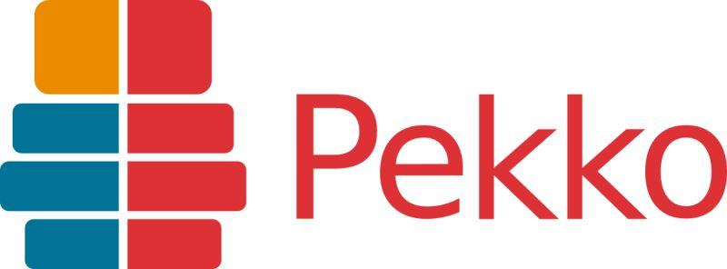
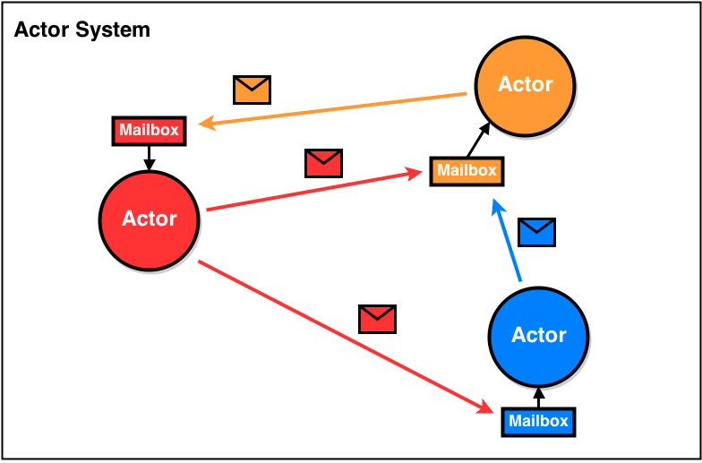
BUILT ON APACHE
What is: is an open-source toolkit and ecosystem designed for the JVM (Java and Scala)
Focus on: Highly concurrent, distributed and resilient appicatiions
Core: Actor Model
a. Actors
b. Asynchronous Messaging and Mailboxes
c. Dispatchers
Resilence: “Let it crash”
Location Transparency: message to local or remote actor is the same
Notes:
Pekko solves this by abstracting concurrency through Actors. A very quick explanation of this model. Actor is an object that encapsulates state and behavior, Instead of calling methods on an object (which would block the thread and require locks if accessed by multiple threads), Actors communicate exclusively through the exchange of asynchronous messages.The sender sends the message to the recipient's "inbox" (mailbox) and does not get stuck waiting for a reply.
Actors are not threads (they are much more lightweight; you can have millions of actors running on a few gigabytes of RAM). Pekko uses components called Dispatchers (The Engine Behind It). The Dispatcher manages a pool of real OS threads and allocates processing time to the actors. If an actor has messages in its mailbox, the dispatcher assigns a thread to it to process a batch of messages, and then releases the thread for another actor. This ensures extremely efficient CPU utilization
Resilience comes with The "Let it Crash" Philosophy. Pekko structures actors in a supervision hierarchy. Each actor has a "parent" (supervisor). If an actor encounters a critical error (such as a database failure or a NullPointerException), it does not try to catch and handle the exception in a complex way. It simply "crashes". The supervising actor is notified of the failure and decides what to do based on pre-defined strategies (e.g., restart the actor by clearing its state, resume operation by ignoring the faulty message, or escalate the failure to its own supervisor). This creates self-healing systems.
Location Transparency. At the code level, sending a message to an actor living in the same JVM or to an actor living on a different node in a Kubernetes cluster halfway across the world is exactly the same thing. Pekko Cluster handles the routing, serialization, and network delivery, allowing the architecture to scale horizontally and transparently.

Slide 5
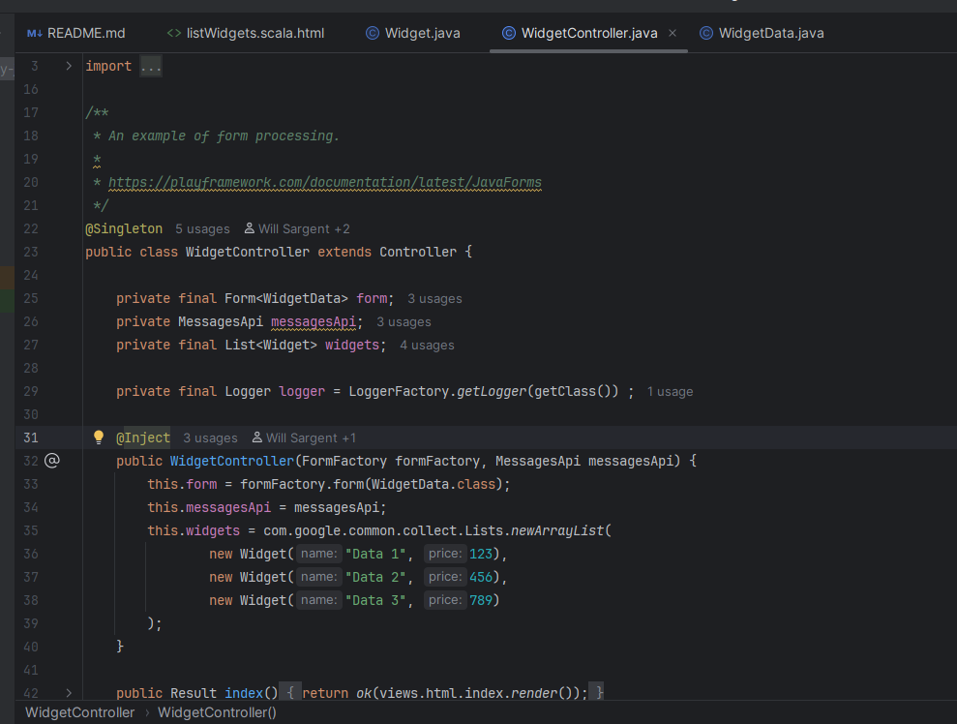
Demo
Notes:
Now let see some code: play video

Slide 6
Alternative Frameworks / Pros and Cons
 | Play Framework 3.0 | Spring Boot (WebFlux) | Quarkus / Micronaut
I/O Model | Reactive (Pekko) | Reactive (Reactor) | Hybrid / Imperative
Hot Reload | Native & Ultra-fast | DevTools (Slower) | Live Coding (Fast)
Type-Safety | Maximum (Routes/Templates) | Medium (Annotations) | High
Memory Use | Low (Stateless) | High (Std) / Low (Flux) | Minimum (Native)
Pros: Horizontal scalability
Security: CSRF, XSS, and SQL Injection protection out-of-the-box
High throughput, low resource consumption.
Cons: Async learning curve;
Smaller ecosystem than Spring.
Notes:
We have some alternatives to Play Framework like Spring Boot with WebFlux and Quarkus. The 3 ones are reactive, the play hot reload and type-safety, Spring brings the strength of its ecosystem, but has a slower hot reload and lower type-safety, Qarkus and Micronaut are the champions of low memory consumption thanks to their native approach.
Pros
horizontal scalability, extremely high performance, and robust out-of-the-box security.
cons
learning curve for asynchronous programming and a smaller ecosystem compared to the giant that is Spring

Slide 7
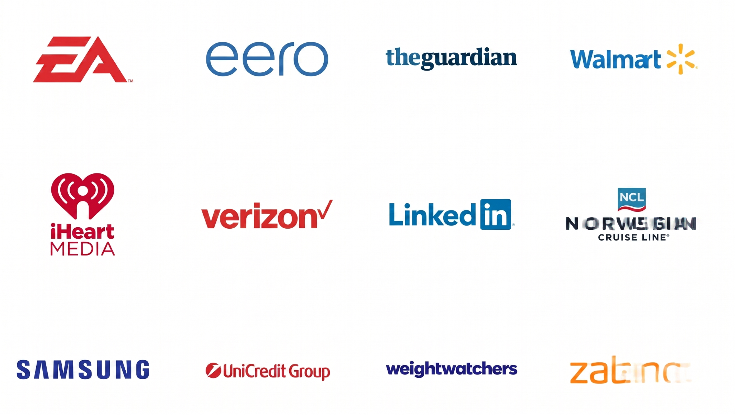
Companies that already using
Notes:
Some companies that use or have used the Play Framework

Slide 8
Questions?
Thank you for your attention!
Visit: www.playframework.com
Notes:
That ´s it. Thank you!

